Slide 1
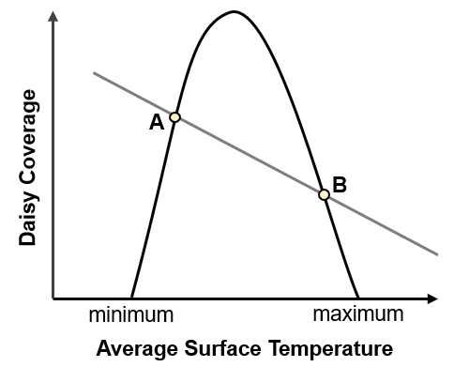

Slide 2
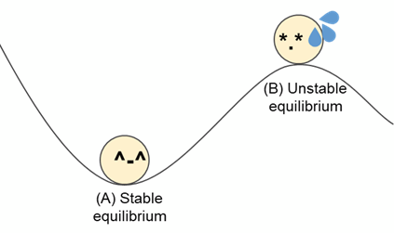

Slide 3
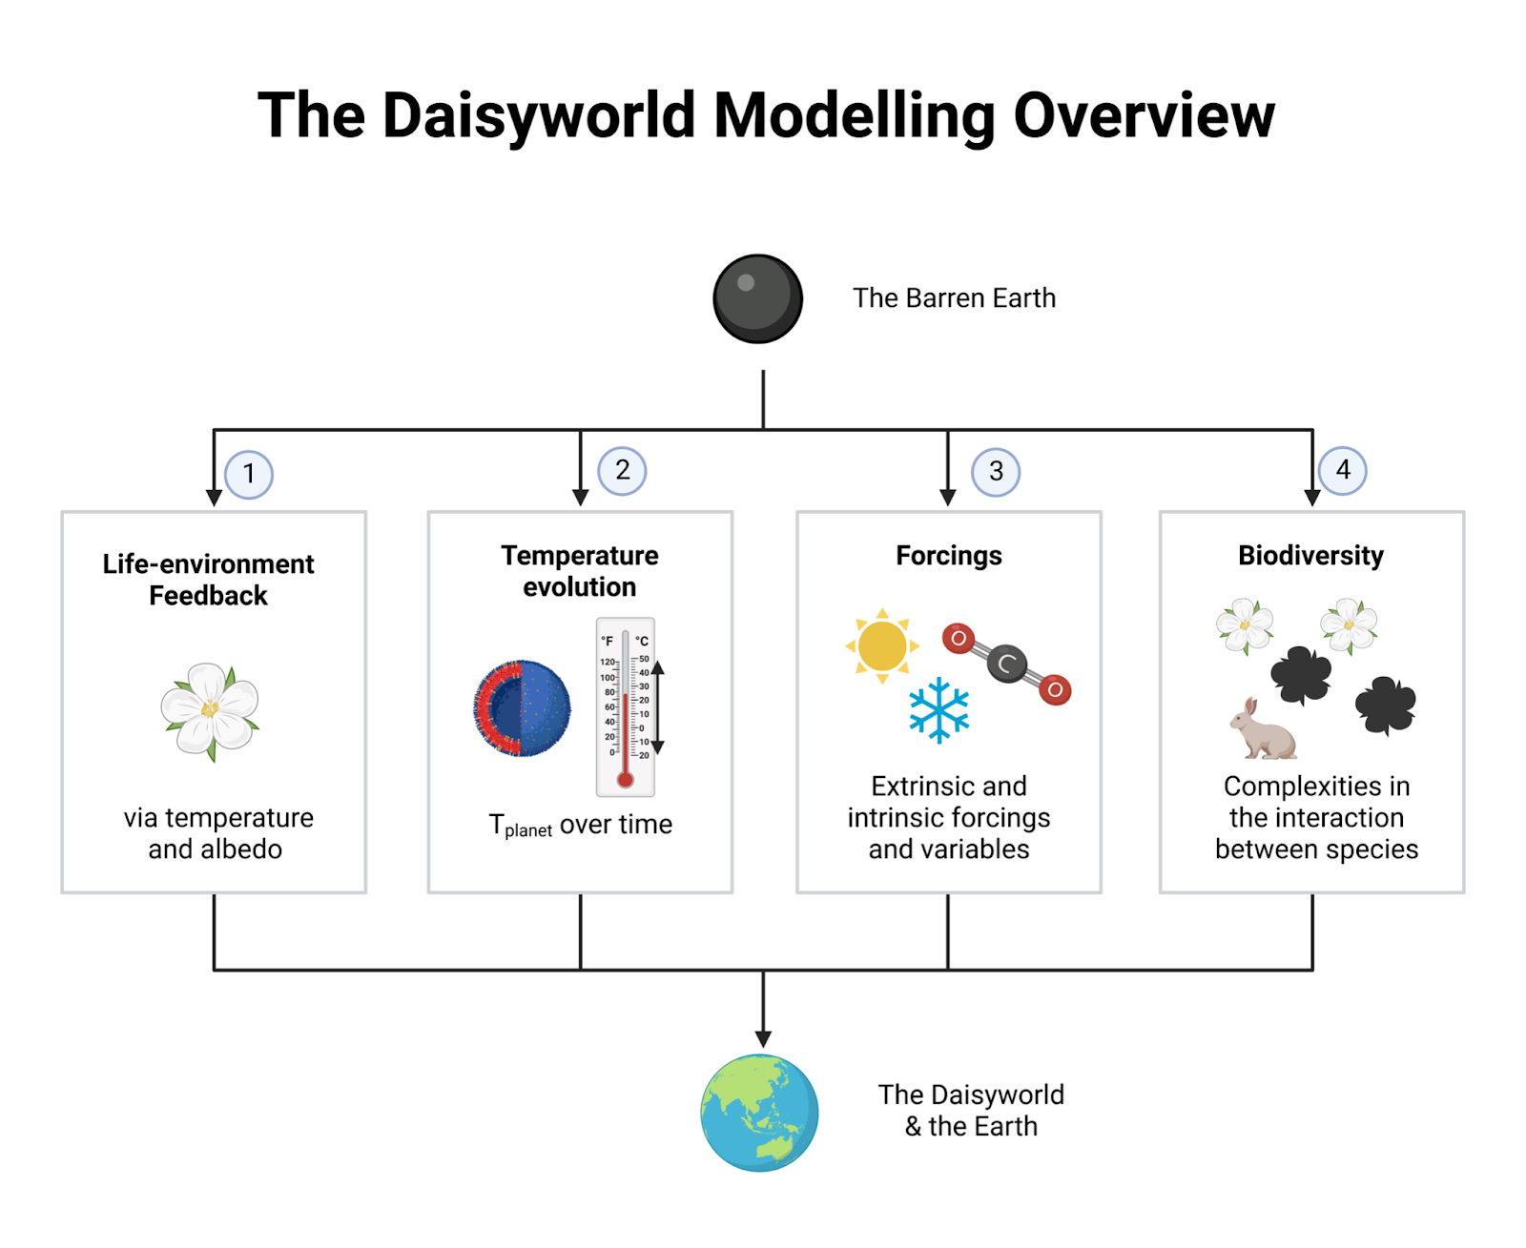

Slide 4






Define parameter values
Create appropriate data structures to store variables of interest
Create a loop
White daisies
Black daisies
Plot out the graph
Update available ground
Save variables of interest
Affected by black daisies
Repeat the process, but for black daisies
Update change in albedo
Update daisy coverage
Affected by black daisies
Update change in temperature
Update growth rate

Slide 5
Define parameter values
Create appropriate data structures to store variables of interest
Create a loop
Exit the loop
Plot out the graph
Update the values of each variable
Save variables of interest
Available ground, albedo, temperature, growth rate, daisy coverage

Slide 6
Define parameter values
Create appropriate data structures to store variables of interest
Create a loop
Exit the loop
Plot out the graph
White daisies
Repeat the variable updates for black daisies
Update the values of each variable
Save variables of interest
Available ground*, albedo*, temperature, growth rate, daisy coverage
*take note of these variables that are affected by the presence of black daisies

